Slide 1
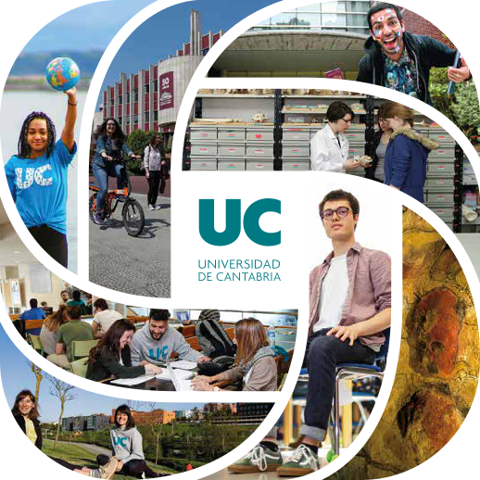
U c i n t e r n a t i o n a l
Vice-Rectorate for Internationalisation and Co-operation
Notes:
Bienvenus, Bienvenidos, Welcome
Virtual tour
A real campus, surrounded by parks, but at the same time integrated in the city,
Very convenient size, 200,000 inhabitants, very manageable, easy to walk around and very safe.

Slide 2
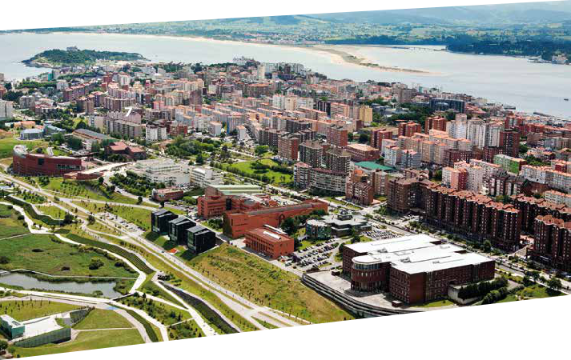
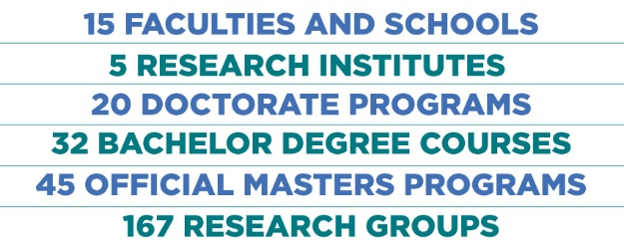
Santander and cantabria

Slide 3
Find your reasons to choose uc
INTERNATIONAL
ATMOSPHERE
Share experiences with students from five continents
ACADEMIC
EXCELLENCE
A varied offer
with approachable
teaching staff
RESEARCH
IMPACT
High level research
applied to the
economic and social
environment
WELCOMING
CAMPUS
Numerous facilities
and services available to students
ENGLISH
FRIENDLY
Study in English
while you’re learning Spanish Or vice versa

Slide 4
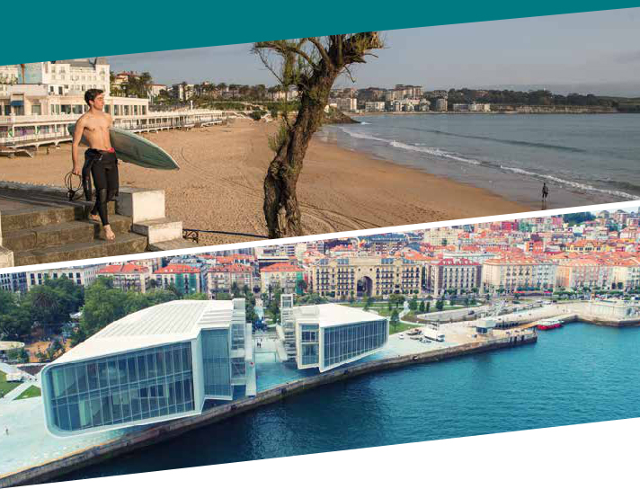
Find your reasons to choose uc
SANTANDER
Vibrant urban life
surrounded by nature, the sea
and beaches
CULTURAL
LIFE
Festivals, exhibitions, lectures… at the University and
in town
QUALITY OF
LIFE
A relatively low cost of living in an easy-going, safe, bike-friendly environment
LINKED TO THE WORLD
An International airport with regular flights to destinations in Spain, Europe and North Africa
WELCOMING
CAMPUS
Numerous facilities
and services available to students

Slide 5
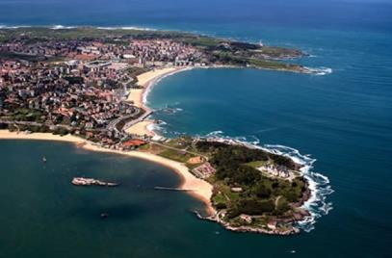
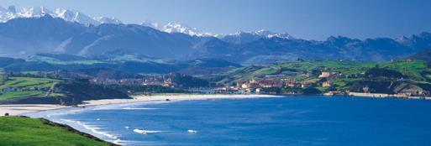
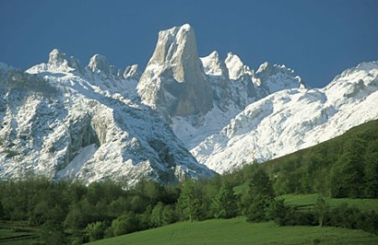
UC: Where we are
Santander (Cantabria), Spain
Notes:
Capital of Cantabria, autonomous region
We enjoy great geographical diversity, beautiful beaches as well as the impressive Picos de Europa, in a couple of hours’ drive

Slide 6
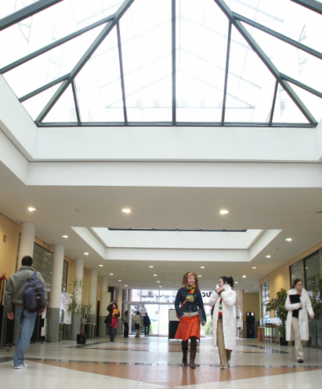
UC: Who we are
A modern public institution created in 1972.
Ranked among the Top Ten Spanish Universities (out of 81) in proportional terms.
Mission: To contribute to social progress through a strong commitment to education and scientific excellence.
UNIVERSITY
Open to the World
SOCIETY
INDUSTRY
Notes:
43 years old, reaching middle-age, we still feel young and dynamic and ready for new challenges

Slide 7
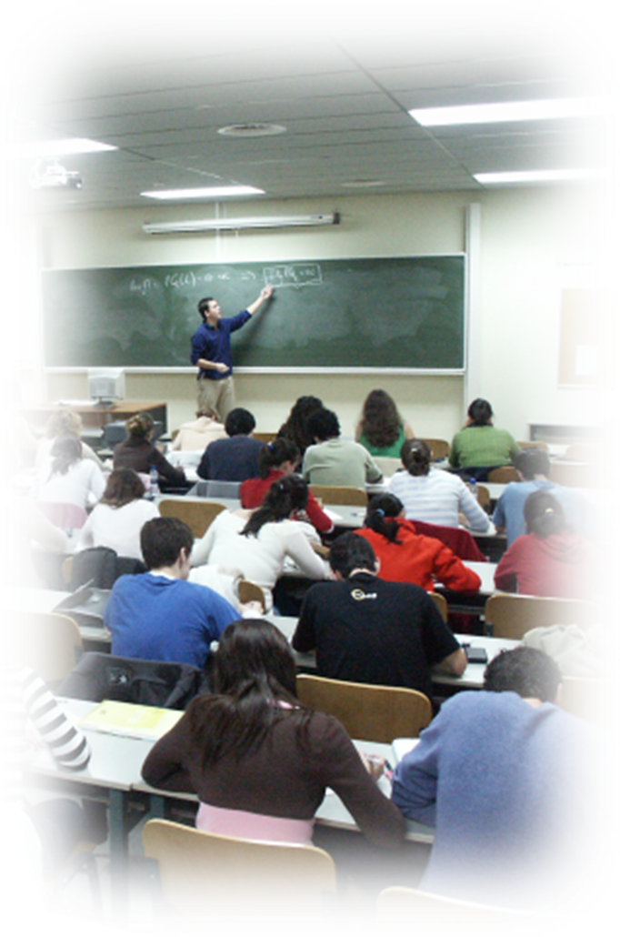
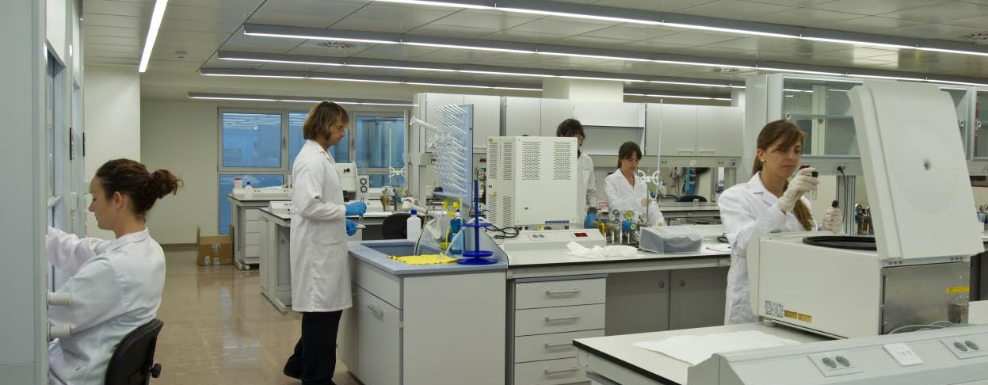
UC: Outstanding Features
Research
Postgraduate Education
Internationalization
Notes:
Medium-sized, but with a few strong points

Slide 8
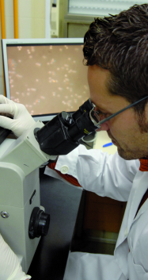
UC in figures
EDUCATION & RESEARCH
Centers and Schools
15 (12+3)
Departments
32
R&D Groups
157
Research Centers and Institutes
7
Students
Undergraduates
9,974
Master & Ph.D.
2,867
Faculty Staff and R&D personnel
1,224
Adm. and Services Staff
572
Notes:
Lots of R & D Groups
Comparatively, we have a large number of students in Post-Graduate programs

Slide 9
The Spanish University System
BACHELOR’S DEGREE
Three cycles
MASTER (specialization)
DOCTORATE (research)
4 years
1 - 2 years
3 years
Professional work

Slide 10
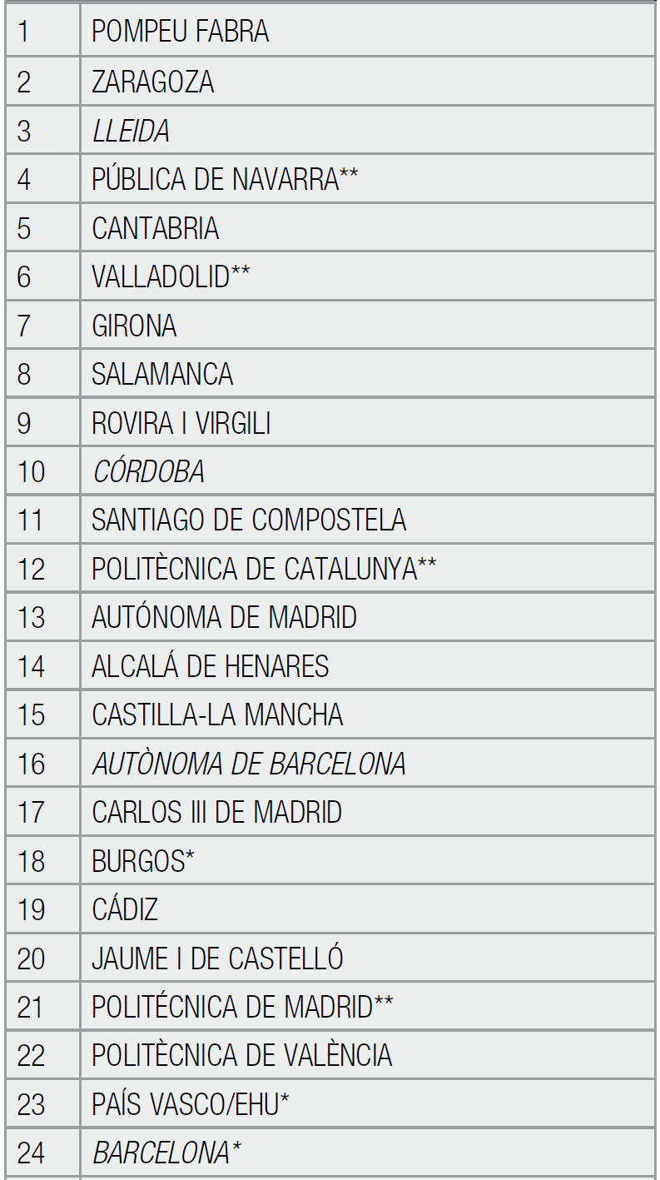
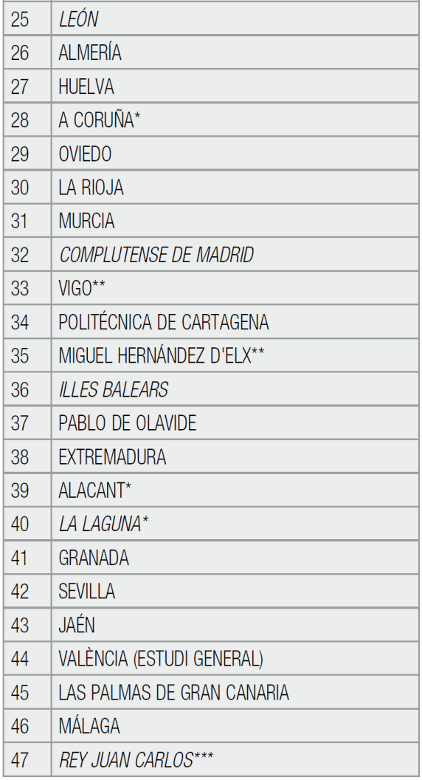
UC: Teaching Excellence
ACADEMIC QUALITY
Prestigious faculty staff
Excellent (<10) students/faculty staff ratio (2nd in Spanish universities)
5th Spanish University by academic quality (CYD Foundation 2010 Report)
1st in Library space (9.3%, compared to an average of 6.2%)
10

Slide 11
Studying at UC
UC studies
Official Studies
UC Masters, 18
Diplomas 17
Postgraduate Specialisation Courses 39
Continuous Training Courses 48
In-company training
Senior Program
Summer Courses
30 Bachelor’s Degrees
42 Official Masters
20 Ph. D. Programs (adapted to the EEES)

Slide 12
Studying at UC
BACHELOR’S DEGREES
ENGINEERING
Chemical Engineering
Civil Engineering
Computer Systems Engineering
Electrical Engineering
Energy Resources Engineering
Industrial Electronic Engineering and Automatic Control Systems
Industrial Technologies Engineering
Marine Engineering
Maritime Engineering
Mechanical Engineering
Mining Resources Engineering
Nautical Engineering and Maritime Transport
Telecommunication Technologies Engineering
SOCIAL SCIENCES
Business Administration and Management
Early Childhood Education and Primary Education Teaching
Economics
Geography and Land Planning
Hotel and Tourism Management
Labour Relations
Law
SCIENCES
Mathematics
Physics
HEALTH SCIENCES
Logopaedics
Medicine
Nursing
Physiotherapy
ARTS AND HUMANITIES
Hispanic Studies
History
Notes:
Very strong in Engineering

Slide 13
Studying at UC
Official Masters
Law and Social Sciences
Access to the Profession of Lawyer
Business Administration
Business and Information Technologies
Economics: Instruments of Economic Analysis
Hotel Administration and Management
Learning and Teaching of Second Languages
Marketing Management (Tourism Businesses)
Research and Innovation in Educational Contexts
Secondary Education Teacher Training
Health Sciences
Advances in Neurorehabilitation of communicative and motor functions
Clinical and Basic Aspects of Pain
Genetic, Nutritional and Environmental Conditioning Factors for Growth and Development
Health Care Research
Integrated Management and Research in Chronic Wounds
Mental Health Research
Molecular Biology and Biomedicine
Transnational Research in Physiotherapy
Engineering and Architecture
Chemical engineering
Civil Engineering
Civil Engineering Research
Coast and Port engineering
Computing engineering
Construction Research, Technology and Management in Europe
Environmental Engineering
Environmental Engineering Research
Industrial Engineering
Industrial Engineering Research
Integrated management of water systems
Integrity and Durability of Materials, Components and Structures
Marine Engineering
Mining engineering
Nautical Engineering and Maritime Management
Telecommunication Engineering
Arts and Humanities
Contemporary History
From the Mediterranean to the Atlantic Master's Degree: The Construction of Europe between the Ancient and the Mediaeval Worlds
Historical and Territorial Heritage
Modern History: 'Monarchy of Spain' 16th - 18th Centuries
Prehistory and Archaeology
Teaching Spanish as a Foreign Language
Territorial Resources and Planning Strategies
SCIENCES
Mathematics and Computing
New Materials
Physics, Instrumentation and the Environment
Theoretical Chemistry and Computational Modelling
Notes:
In the post-graduate level the different fields of study get a more balanced share

Slide 14
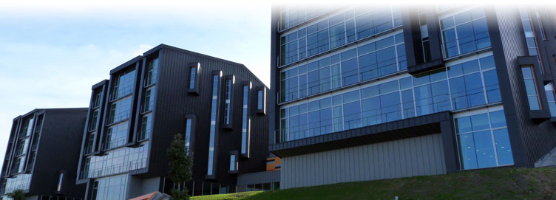
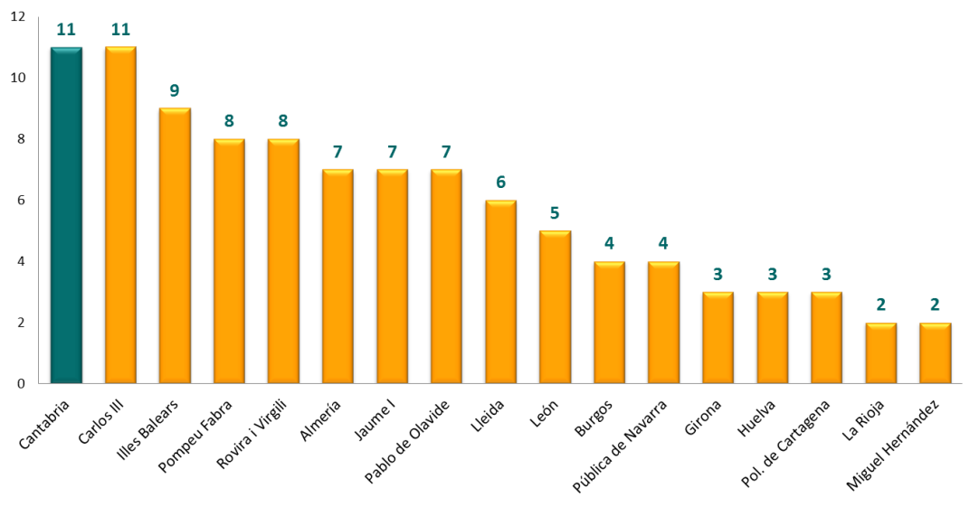
UC Ph.D. studies
First Spanish University with a Doctoral School
Ph. D. studies offered in a variety of fields linked to the lines of research carried out in 32 departments
In the latest assessment, 65% UC doctoral programmes obtained the highest Quality Standard granted by the Spanish Government.
Doctoral Programs with the Excellence Award from the Spanish Ministry of Education
Compared to other Universities of similar size (up to12.000 undergraduate students)

Slide 15
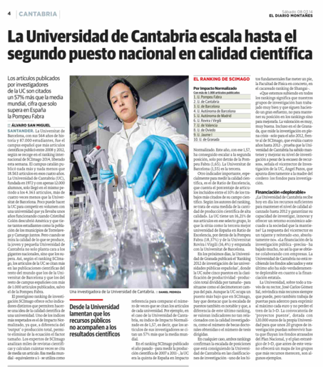
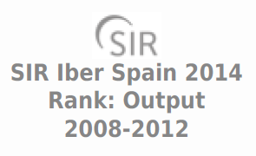
UC: Outstanding in Research
RANKINGS
Research is one of the most relevant features of the UC.
Ranked in the top 150-200 Universities in the world in Physics (Shanghai ranking)
According to the most important Spanish rankings, the UC is among the Top Ten Universities in proportional terms.
1st in research output/budget ratio
2nd Public University in research quality (Scimago 2014).
10th Spanish University in international collaborations
Scimago Institutions Ranking World Report, 2012 (España)
Observatorio IUNE (Investigación en Universidades españolas)
G9, Univalue

Slide 16
Academic and entrepreneurial support
Top universities and networks
Harvard
University
Cornell
University
Leading multi-sector companies

Slide 17
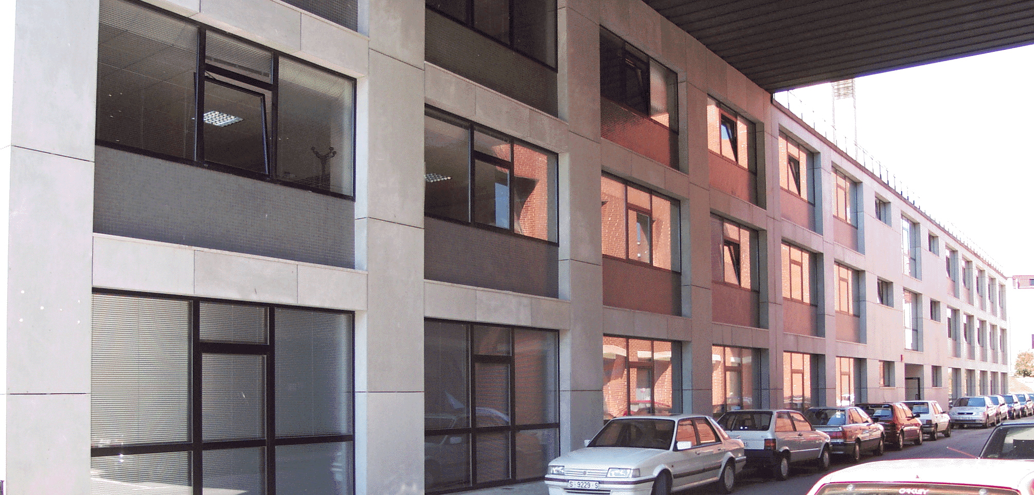
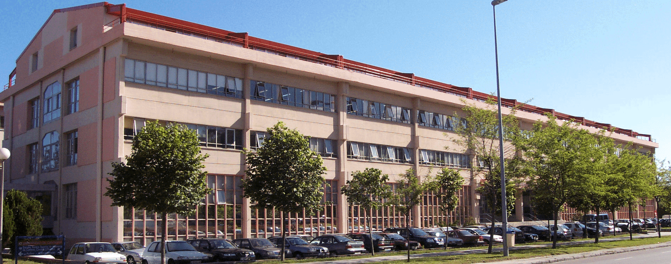
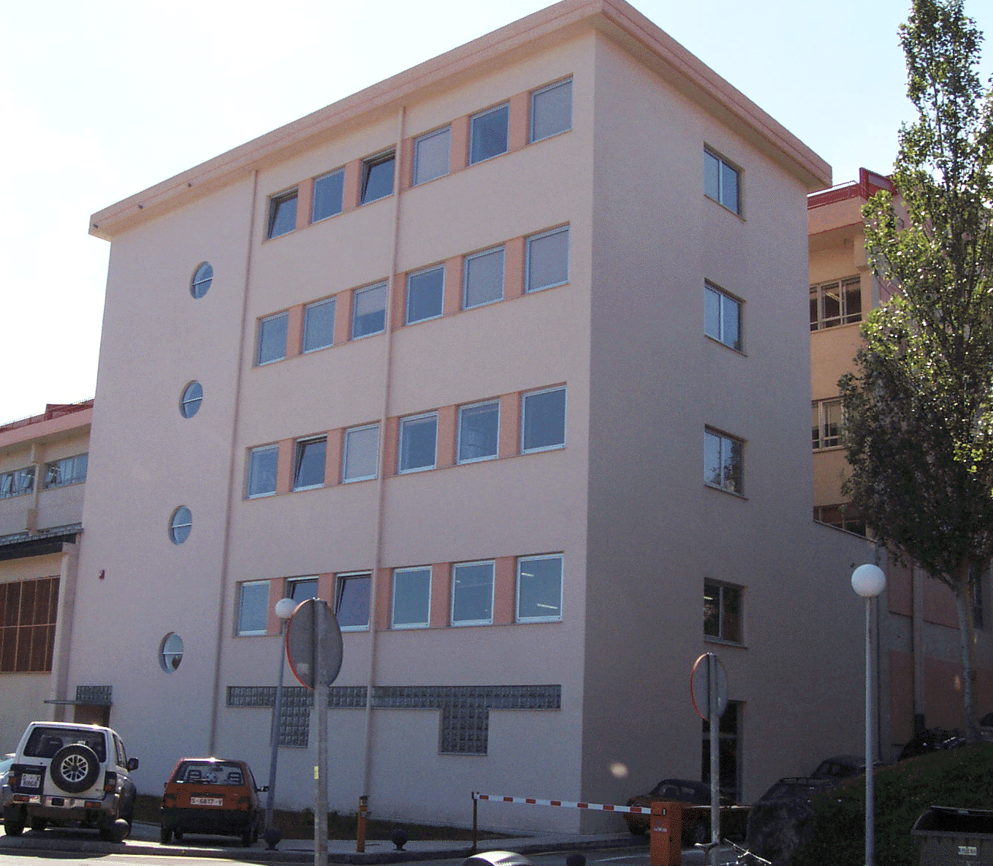
Research and Knowledge Transfer
FLTQ: A TOOL TO KNOWLEDGE TRANSFER
Created in 1999 to promote the links between the University and private companies.
Established companies and research groups work together in an atmosphere dedicated to R&D projects.
Iberoamerican University network of incubation of companies created in 2006.
The target is to facilitate the transfer of the results of the research to society.
A new forum to establish contacts between researchers and companies
17

Slide 18
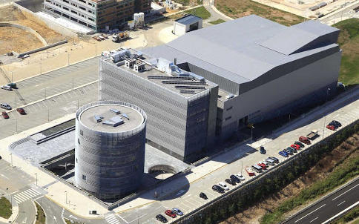
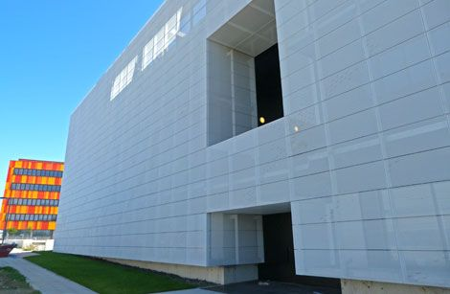
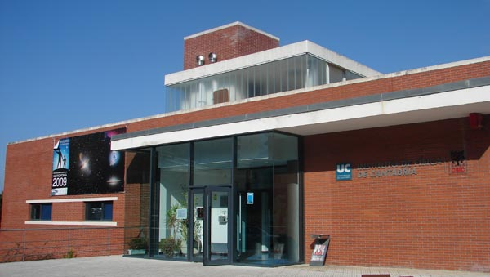
UC: Research Centers and Institutes
Research Institutes
Environmental Hydraulics Institute "IH Cantabria“
Institute of Biomedicine & Biotechnology of Cantabria(IBBTEC)
Institute of Physics of Cantabria (IFCA)
International Institute for Prehistoric Research (IIIPC)
Research Centers
Santander Financial Institute (SANFI)
Santander International Entrepreneurship Centre (CISE)
Smart Cities Research Centre (CICIS)

Slide 19
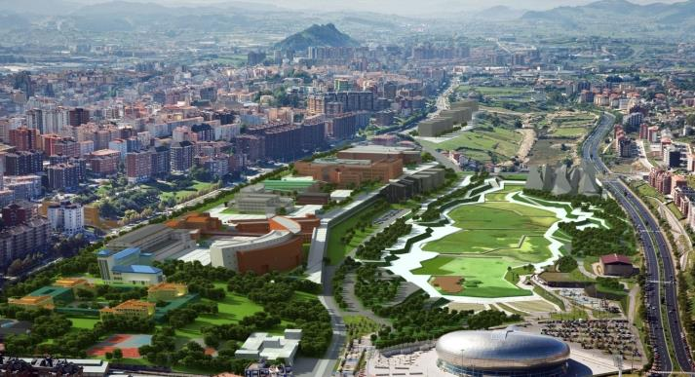
Cantabria International Campus (CCI)
Official designation by the Spanish Ministry of Education (2009), consistently reviewed positively (latest positive review 2015).
Inspiration from the concept of “Campus Integral” recommended by OECD: knowledge with sustainability as an essential condition to ensure development in the region.
Trying to promote an “Ecosystem of Knowledge”: Leading the region in a model of growth based on the strategic aggregation of public and private agents, the creation and transfer of knowledge, social cohesion, and economic development.
Notes:
:
Our University’s project was one of the first 9 Spanish Universities in 2009, and has been consistently reviewed positively:
Trying to promote “Ecosystem of Knowledge”: Leading the region in a model of growth based on the strategic aggregation of public and private agents, the creation and transfer of knowledge, social cohesion, and economic development.

Slide 20
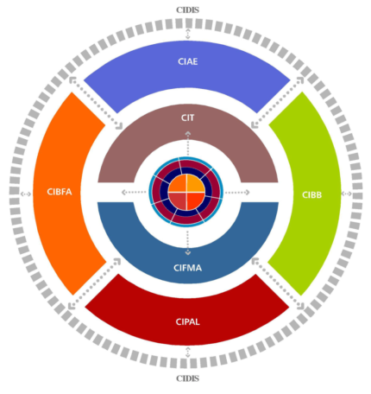
Strategic areas of CCI: Excellence in research
Water and Energy
Biomedicine and Biotechnology
Banking, Finance and Business
Heritage and Language
Technology
Physics and Mathematics
Knowledge Transfer and Social Development

Slide 21
UC: Social responsibility
Social and Gender policies
Cooperation for Development
UC Plan for Gender Equality
Balancing family and work
Kindergarten
Holiday campus for kids
Plan for an Active and Healthy life
Cooperation Projects
Fair Trade campaigns
Volunteer Programs
Social compromise

Slide 22
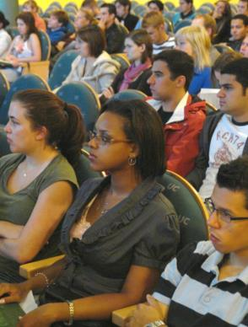
UC: Open to the World
Vice-rectorate for Internationalisation and Co-operation
Fostering international mobility
Inwards and outwards.
Students, Faculty and Administrative Staff.
Institutional agreements throughout the world
Main links with Europe and Latin America.
The US as a strategic partner.
New horizons: BRIC.
Enhancing English proficiency at the UC
Increasing academic offer in English.
Language requirement for all undergraduates.
Promoting Internationalisation of Masters and Doctoral studies.
22
Notes:
Developing countries

Slide 23
UC: Open to the World
UC is a member of national and international university networks

Slide 24
UC Agreements with other countries
Student Mobility Agreements with prestigious universities
Mobility flows (incoming+outgoing) : more than 850 students per year
Europe: 230 bilateral agreements
Latin America: 145 bilateral agreements
USA, Canada and Australia: 20 bilateral agreements
Africa: 5 bilateral agreements
Asia: 2 bilateral agreements

Slide 25
The US as a strategic partner
Cornell University
University of Pennsylvania
Brown University
Princeton University
Harvard University
University of North Carolina- Charlotte
University of Miami
State University of New York (Buffalo)
Oregon State University
University of California, Berkeley
The University of Texas at Austin
University of Rhode Island
Western Michigan University
University of Central Florida
University of North Florida
Baylor University, Texas
Whittier College, Los Angeles (CA)
University of Tulsa, Oklahoma
University of Pittsburgh, PA
Student exchange agreements with many prestigious US Universities
About 40 incoming US regular students per academic year

Slide 26
UC Language policy
Our goal:
To enhance English Proficiency among UC members
UC is doing a major effort to improve the use of English at all levels
Undergraduates are required to achieve an independent level of English before graduation
UC finances a variety of English training courses, reaching around one thousand students per year
Increasing offer in English in all degrees
UC evaluates the ability of its staff to teach in English. Around 320 teachers have been certified

Slide 27
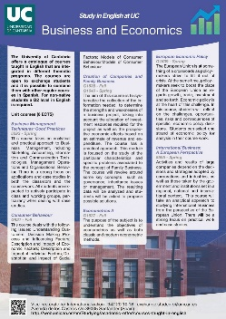
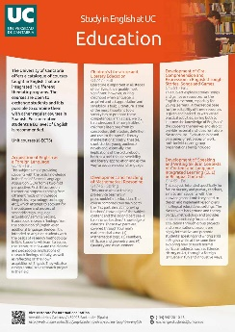
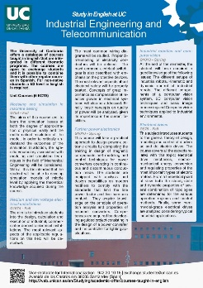
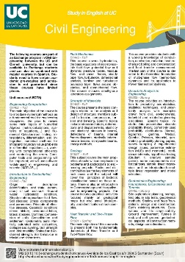
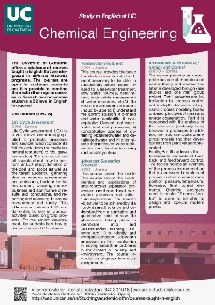
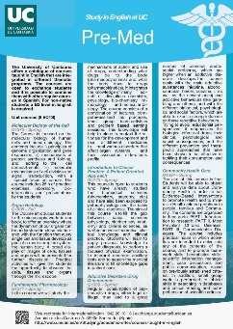
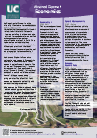
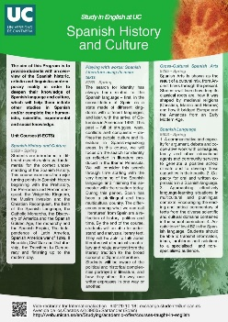
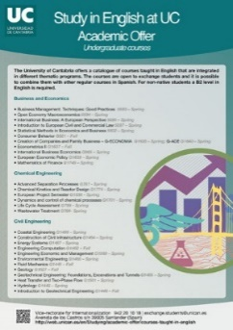
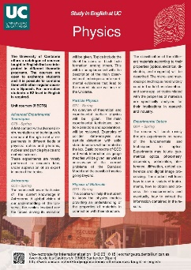
UC: Academic offer in English
PROGRAMS TAUGHT IN ENGLISH
Advanced Diploma in Economics
Chemical Engineering
Civil Engineering
Education
European Business and Economics
Industrial Engineering and Telecommunications
Physics, Mathematics & Computer Science
Pre-Med
Spanish History and Culture
Increasing offer in English in all degrees
http://web.unican.es/en/Studying/academic-offer/courses-taught-in-english
UC-CU
CORNELL-CANTABRIA
EXCHANGE PROGRAM
IN CIVIL ENGINEERING

Slide 28
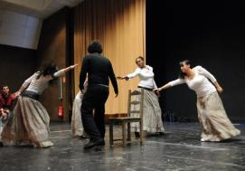
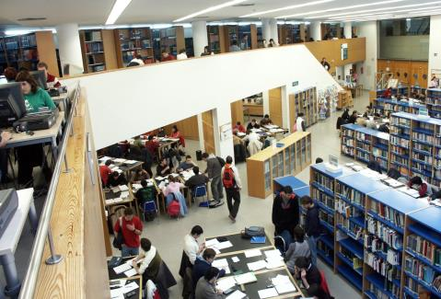
UC: Student services
University library
Extramural services
Cultural activities
Sports services
Computer services
Language Center
Psychological Attention Service for Students (SOUCAN)
Careers and Employment Information Center (COIE)
Student Council and Association (CEUC)

Slide 29
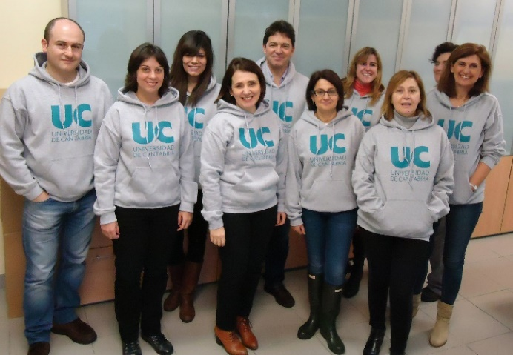
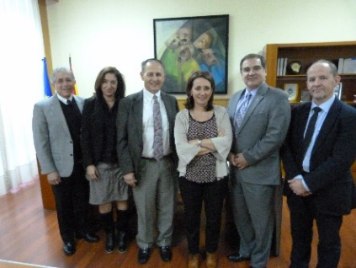
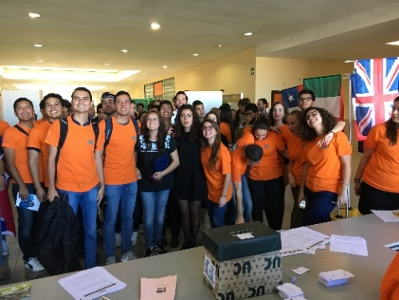
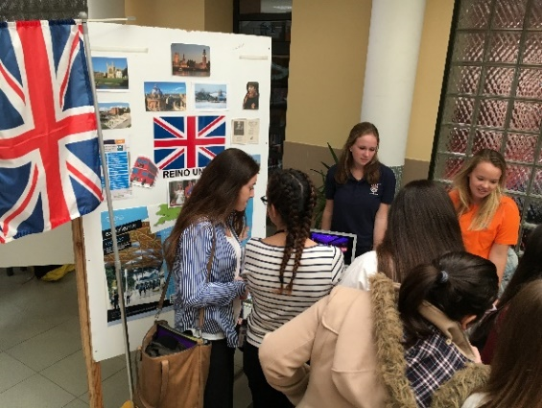
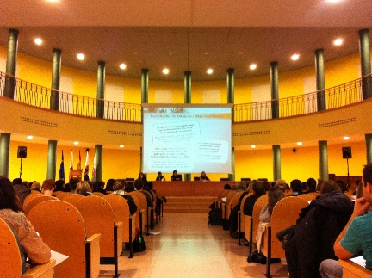
UC: International Relations Office
Oficina de Relaciones Internacionales (ORI)
Information about application, visa requirements, insurance, etc.
Administrative management
Assists students with housing
Issues UC Identity card
Reference point for foreign students before and during their stay at UC
http://web.unican.es/en/Studying/practicalities/the-uc-international-relations-office

